Slide 1
LOGICAL FALLACIES
(PART 2)
Mirko Farina
Assistant Professor
m.farina@innopolis.ru
* I do not claim authorship for all texts and pictures in the presentation.

Slide 2
4 Major Types of Fallacies
Fallacies of Diversion (LAST WEEK)
Fallacies of Structure (LAST WEEK)
3. Fallacies of Language (TODAY)
4. ‘Ad Arguments’ (TODAY)

Slide 3
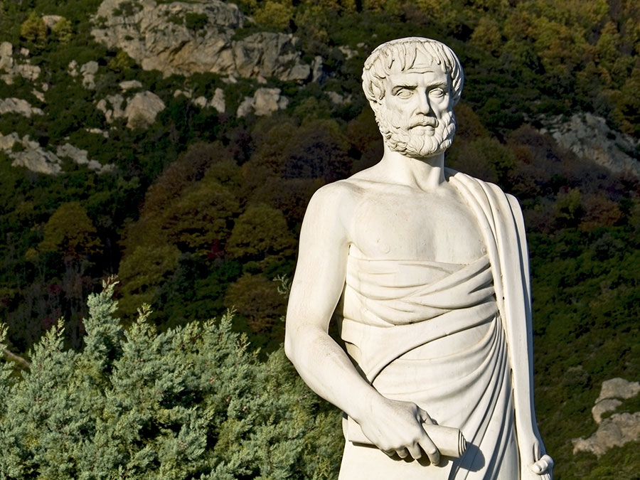
Fallacies of Language
Aristotle in the sophistical refutations divided fallacies into those that depended on language and those that did not
Among the fallacy related to language he included the following:
1. Equivocation; 2. Amphiboly, 3. Combination of Words, 4. Division of Words, 5. Accent, and 6. Form of Expression.

Slide 4
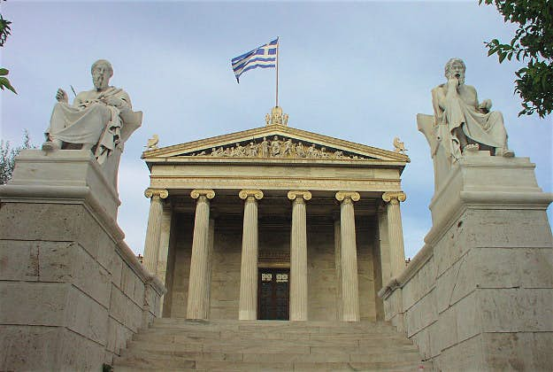
Some of the fallacies (3,4,5,6) were related to the specific Socratic context in which Aristotle was trained (Plato’s Academy) and outside of that context do not make sense.
That is the reason why in this lecture we focus on 1 and 2 as these are those that survive in the modern world.

Slide 5
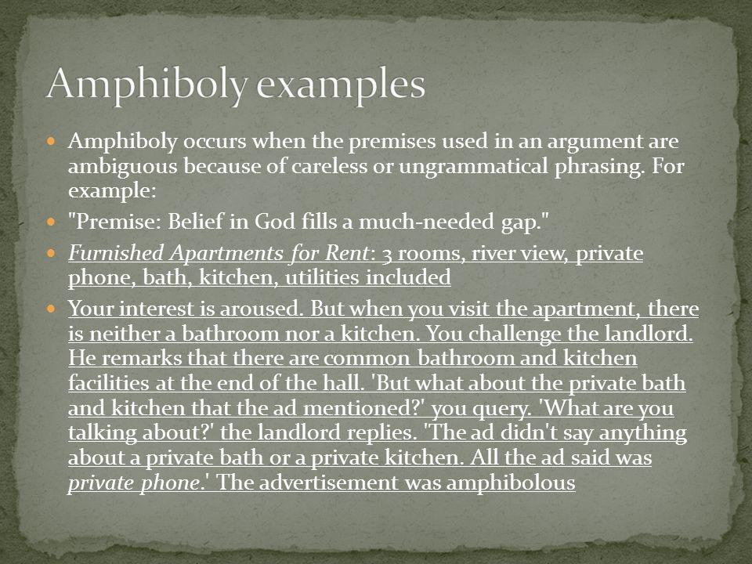
Amphiboly
The remaining two:
Equivocation and Amphiboly both involve ambiguity.
For Amphiboly this ambiguity arises from the sentence structure. The words used are unambiguous in themselves, but when put together in a statement they create an ambiguity.
EXAMPLE: ‘Watch repairs here!’
This is ambiguous because of multiple possible meanings that can be attached to the statement

Slide 6
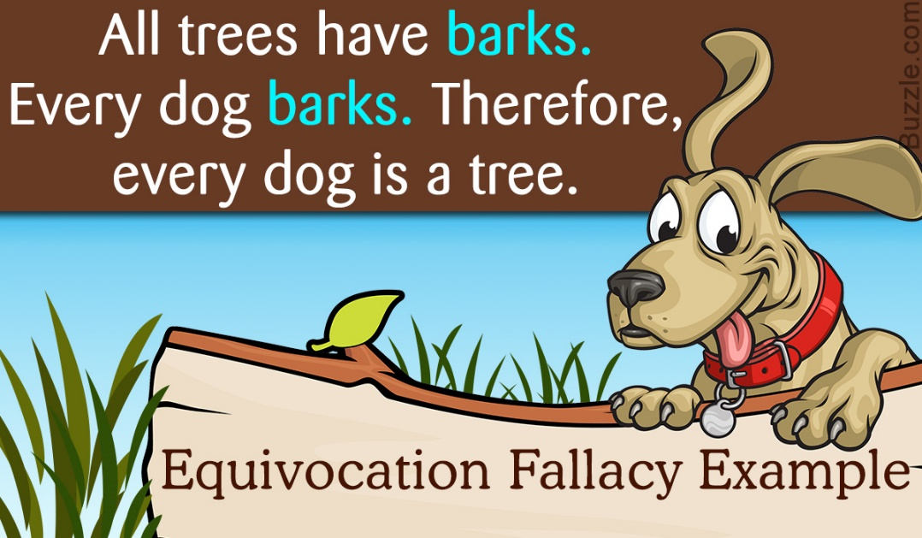
Equivocation
Equivocation
involves the shifting of meaning of a term, concept, or phrase within the process of an argument. Hence, arguments that equivocate in this way are fallacious arguments.
For example, although a term may be introduced with one meaning, over the course of the argument another meaning of the same term is introduced or assumed

Slide 7
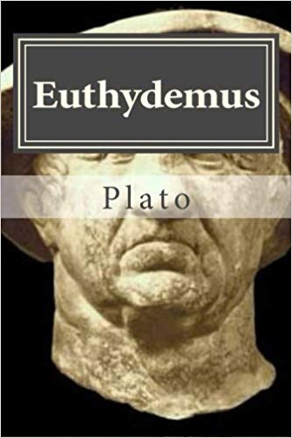
This is part of a discussion from Plato’s dialogue Euthydemus (298E):

Slide 8
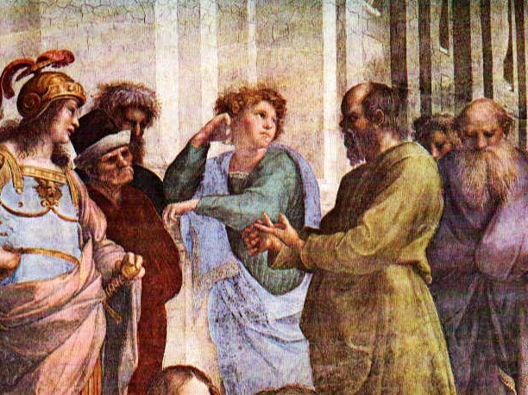
EXAMPLE 1
‘[Dionysodorus]: Ctesippus, just tell me this, have you a dog?
Yes, a real rogue, said Ctesippus.
Has he got puppies?
Yes, a set of rogues like him.
Then is the dog their father?
Yes, indeed; I saw him with my own eyes covering the bitch.
Well now, is not the dog yours?
Certainly, he said.
Thus he is a father, and yours, and accordingly the dog turns out to
be your father, and you a brother of whelps’.

Slide 9
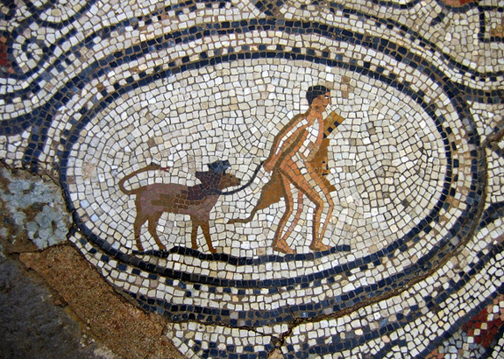
This is a classic case of Equivocation, from one of the earliest accounts dealing with fallacies.
Yet many people have had trouble deciding exactly what goes wrong here.
Succinctly put, Dionysodorus’s argument is ‘You have a dog, the dog is a father, and therefore the dog is your father’.

Slide 10
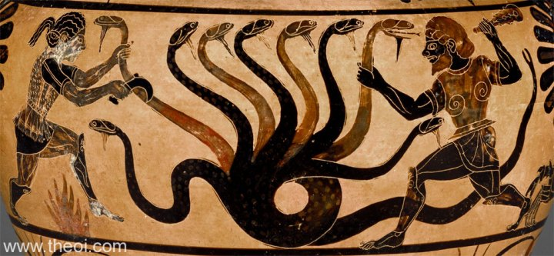
For our purposes, we can appreciate that something can ‘be yours’ in a wide range of senses, from your idea to your turn to your place in history.
The meaning of one sense cannot be transferred to another. This is what Dionysodorus’s argument purports to do, from ‘your dog’ to ‘your father’.
Once we appreciate that we do not possess a dog in the way we have a father, the nature of the fallacy emerges

Slide 11
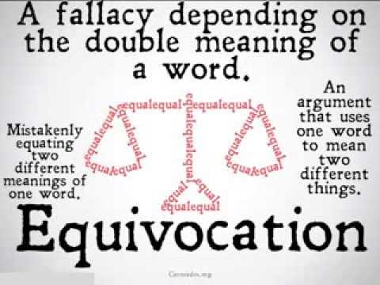
Note here that the equivocation of the term is committed by the same participant in the argumentative dialogue.
That is, the one who first introduces the term and its meaning is the same person who subsequently shifts the meaning.
If we have two arguers who are simply assuming different senses of a term, concept, or phrase, we would not say that either of them has committed a fallacy of Equivocation.

Slide 12
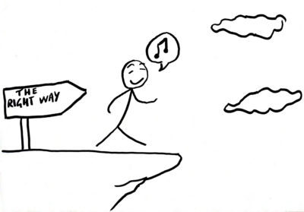
Instead, we would judge that they had engaged in a dispute that was really verbal rather than real, since once the ambiguity was resolved it may transpire that they do not actually disagree.
Or, it may be that the second arguer has constructed a Straw Man by attributing a meaning to the first arguer that he or she did not intend.

Slide 13
EXAMPLE 1
Your claims about an increase of aging drivers with dementia fan the
flames against older motorists. The big risk, so you claim, is the coming
multitude of drivers with dementia unleashed on the highway.
You give the impression of a multitude of safe, younger drivers inundated
by a growing minority of demented seniors at the wheel. The
risk is worse because the signs of dementia “are so subtle.” Anyone
driving in a major city today does not have to look hard to find signs of
demented drivers, but few of these are aged, and the indications are not
so subtle. We have young and middle-aged (rarely old) drivers chatting
obliviously on cellphones as they perilously negotiate crowded
streets at hazardous speeds, we have the mid-30s executive in his/her
SUV charging through red lights, we even have the youthful bicycle
courier risking his life – and that of others – on the road.

Slide 14

The conclusion is being drawn about the
term ‘demented’ in one sense, whereas the supporting premises involved that term in a different sense.
As the term ‘dementia’ (or ‘demented’) is used to refer to older people it means an illness; but as it applies to irresponsible drivers (of all ages) it refers to
craziness.

Slide 15
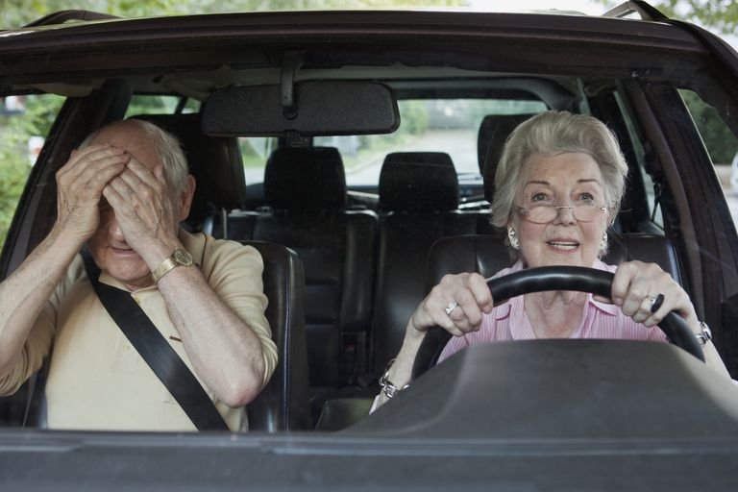
The difference is between being in a certain state and
acting as if one were in a similar state.
The arguer’s position is that we face more danger from people who act in crazy ways. But what is said fails to address the relevant question because of the equivocation.

Slide 16

The arguer appears to be talking about the same thing
throughout and stays on the topic of safe driving. It is only by close attention to the terms used and their different senses that we catch the shift that has occurred

Slide 17
How to avoid it? Ask yourself the following questions:
1. Have key terms, concepts, or phrases retained their initial meanings throughout the argument?
2. Does any shift of meaning indicate that the conclusion fails to prove what it was supposed to prove?

Slide 18
Ad Arguments
1. Ad Hominem
2. Ad Populum
3. Ad Baculum 4. Ad Misericordiam
5. Ad Ignorantiam

Slide 19
In the wide public domain, where controversial issues are debated and personalities invariably clash, the strategy of attacking an opponent because of some real or perceived characteristic, circumstance, or association is particularly prevalent.
The strategy of attacking the person falls under the general umbrella of ethotic arguments, that is, arguments that deal with some feature of the character of the speaker

Slide 20
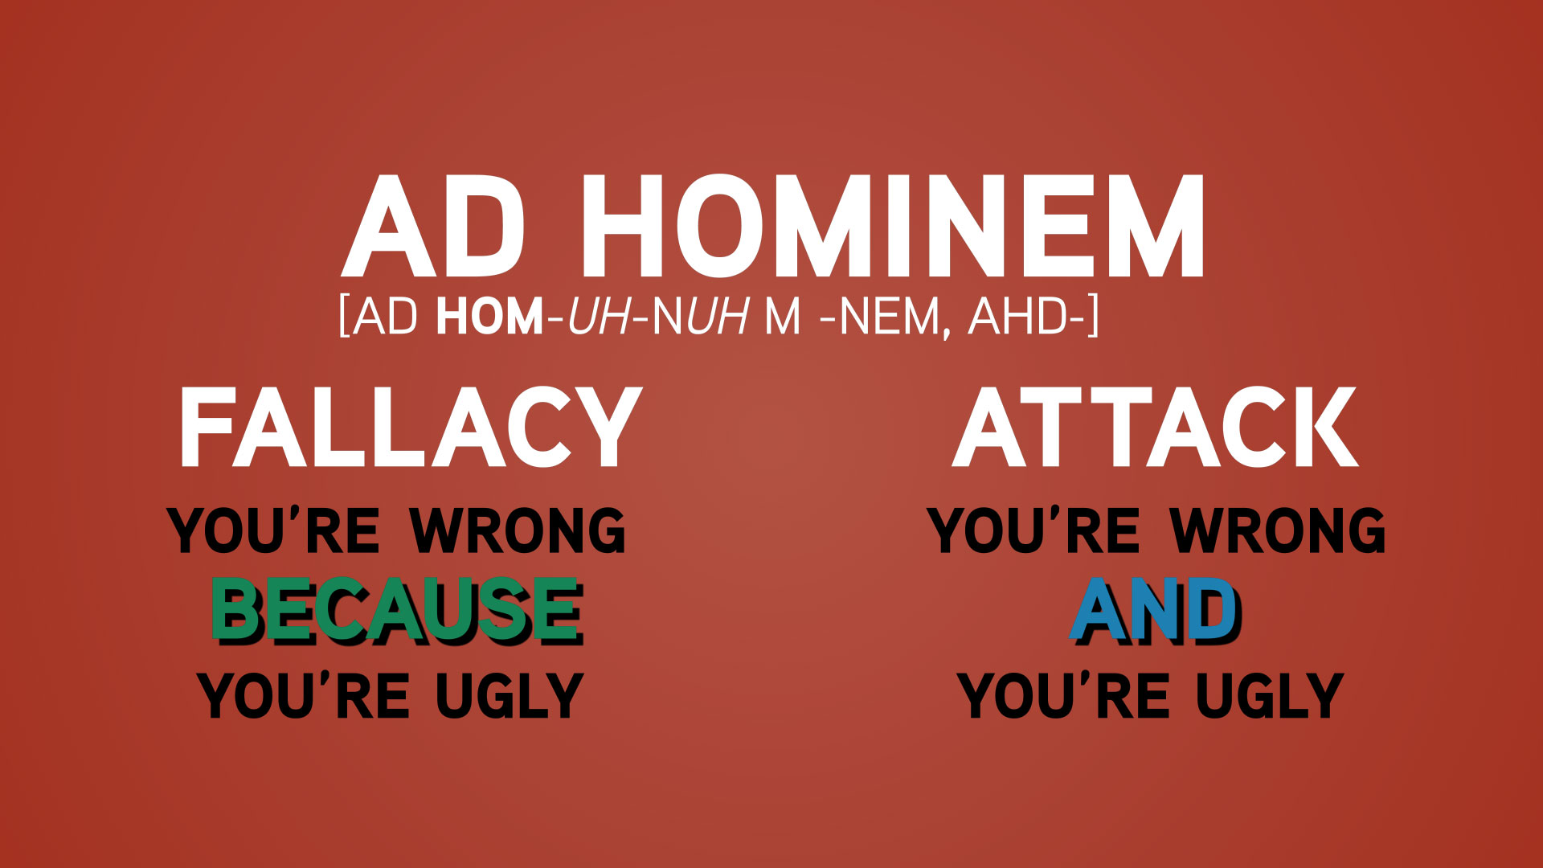
Where the attack is problematic in particular
ways, we charge the attacker with committing the fallacy called argumentum ad hominem (argument against the person).

Slide 21
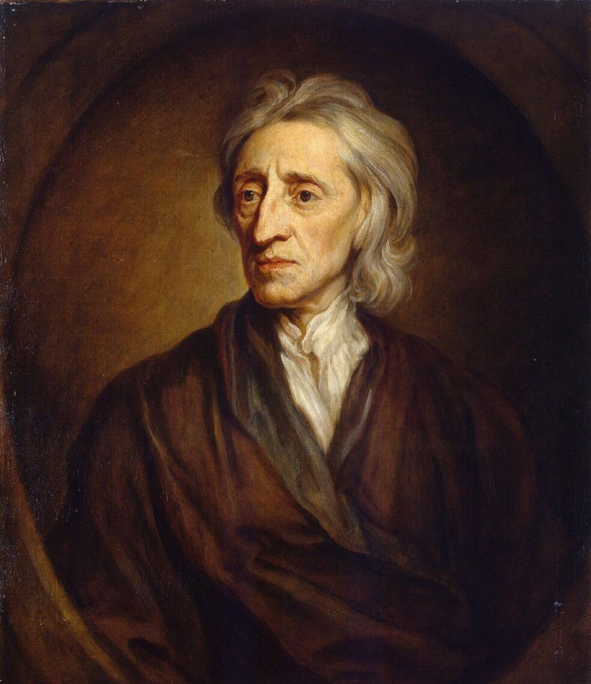
The first philosopher to draw attention to the ad hominem
is John Locke (1632–1704), even though Aristotle clearly described this fallacy in his Sophistical Refutations.

Slide 22
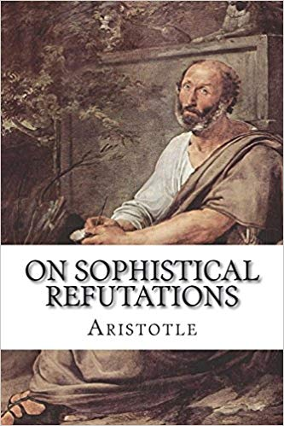
Aristotle writes with reference to an example, “this solution will not suit every argument . . . but is directed against the questioner, not against the argument.”

Slide 23
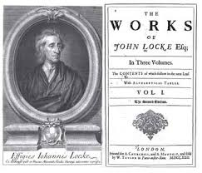
Locke subsequently introduced this fallacy as one of the 4 types of argument that people may use to persuade others or at least silence their opposition.

Slide 24
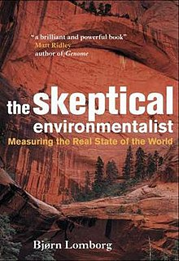
EXAMPLE 1
Context: a book - The Skeptical Environmentalist- published in 2001 by Bjørn Lomborg, who is
Danish political scientist.
Hot debate between him and the scientific community (experts in the field of environmental science)

Slide 25
‘And who is Lomborg, I wondered, and why haven’t I come across him at any of the meetings where the usual suspects debate costs, benefits, extinction rates, carrying capacity or cloud feedback? I couldn’t recall reading any scientific or policy contributions from him either. But
there was this massive 515-page tome with a whopping 2,930 endnotes to wade through. …..

Slide 26
….On page xx of his preface, Lomborg admits, “I am not
myself an expert as regards environmental problems” – truer words are not found in the rest of the book, as I’ll soon illustrate. I will report primarily on the thick global warming chapter and its 600-plus endnotes.
That kind of deadweight of detail alone conjures at least the trappings of comprehensive and careful scholarship. So how does the reality of the text hold up to the pretense? I’m sure you can already guess, but
let me give some examples to make clear what I learned by reading….

Slide 27

The first reason given to undermine Lomborg’s work is an ethotic one, derived from the wondering about Lomborg’s absence from previous debates on such issues and his lack of contribution to the scientific literature
on the subject

Slide 28

The implication is that Lomborg (despite being an academic) is not a scientist and has not earned his “stripes” in the field.
Clearly, this is an attack against the person, aimed at weakening his credibility in the minds of the audience before any of Lomborg’s actual arguments have been considered.

Slide 29
How to Avoid it? Ask yourself the following questions
1. Has an attack been made on another person in an argumentative debate?
2. Has that attack focused on the person’s character or circumstance and avoided any discussion of his argument?
3. Where a conclusion has been drawn about the opponent’s position or claim, is the ad hominem material introduced in the premises relevant to your appraisal of the position or claim, and are there grounds for believing the material is factually correct?

Slide 30

Having described the general ad hominem reasoning we can now focus on two specific versions of the ad hominem.
A. Abusive ad hominem
B. Tu quoque

Slide 31

A. Abusive Ad Hominem
As its name suggests, the abusive ad hominem involves a direct attack on an individual’s character rather than some circumstance related to him
However simply calling someone names, while counterproductive
to good communication, is not itself fallacious. So we need to be
sure that the person has provided both premises and a conclusion in the process

Slide 32

EXAMPLE 1
Mr. Pelletier insisted Ms. Bedard’s claim that Group action Marketing Inc. often over-billed Via Rail should not be believed.] “I don’t want to be mean, but this is a poor girl who deserves pity, who doesn’t have a spouse, as far as I know,” he said. “She is struggling as a single mother with economic responsibilities. Deep down, I think she is pitiful.

Slide 33
Rather than address Ms. Bedard’s charges, Pelletier chooses to attack her personally because she is a single mother who deserves pity.
But he is offering an argument: he is somehow proposing that these facts about her are grounds not to believe what she says. His abusive ad hominem fails the third of our earlier critical questions: he draws a conclusion about her position (it should be disbelieved), but the reasons provided are quite irrelevant to it and so his ad hominem argument is fallacious.

Slide 34
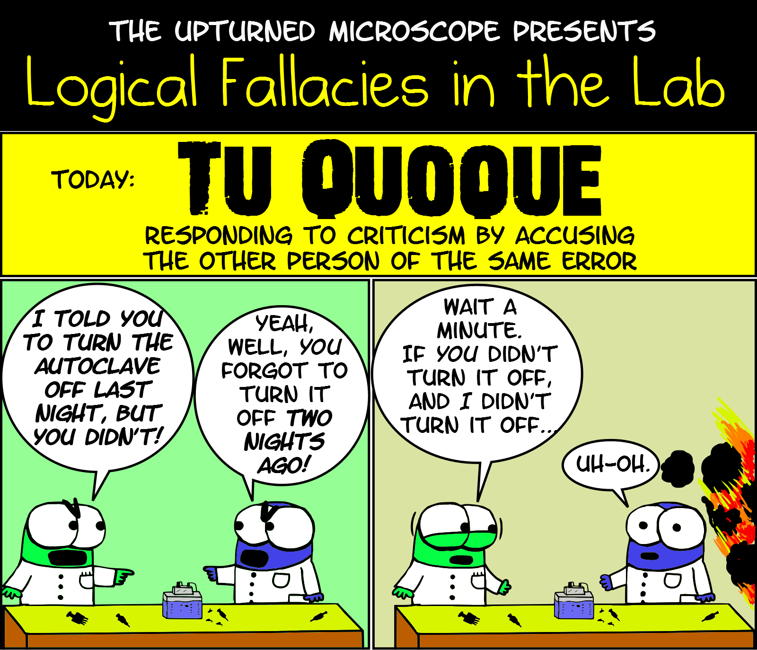
B.Tu quoque
It translates as “you too,” and effectively suggests that
there is an inconsistency between what a person does and what he says, or what he has said in the past and what he is proposing now. That is, the person is guilty of the very charge he is now making.
The inconsistency is pragmatic rather than logical

Slide 35
EXAMPLE 1
Majority member Joe C. is under fire for using public funds to pay for more than $44,000 in expenses. Minority members accused the majority floor leader of having one standard in opposition and quite another standard in government. In defense of Joe C., the majority floor leader pointed out that a minority member (while in the previous
majority) had himself been questioned about his expenses, including out of state travel expenses.

Slide 36
Note that both parties to this dispute are employing a tu quoque, one in attack and the other in defense. The critics of the majority floor leader accuse him of inconsistency in that he seems to be prepared to defend the very behaviour that he attacked when he was in the minority ranks.
In defense the majority leader claims “You too” and points to the behaviour of one of the critics’ own people when they formed the majority; the implication is that they
too were prepared earlier to defend behaviour that they now are attacking

Slide 37
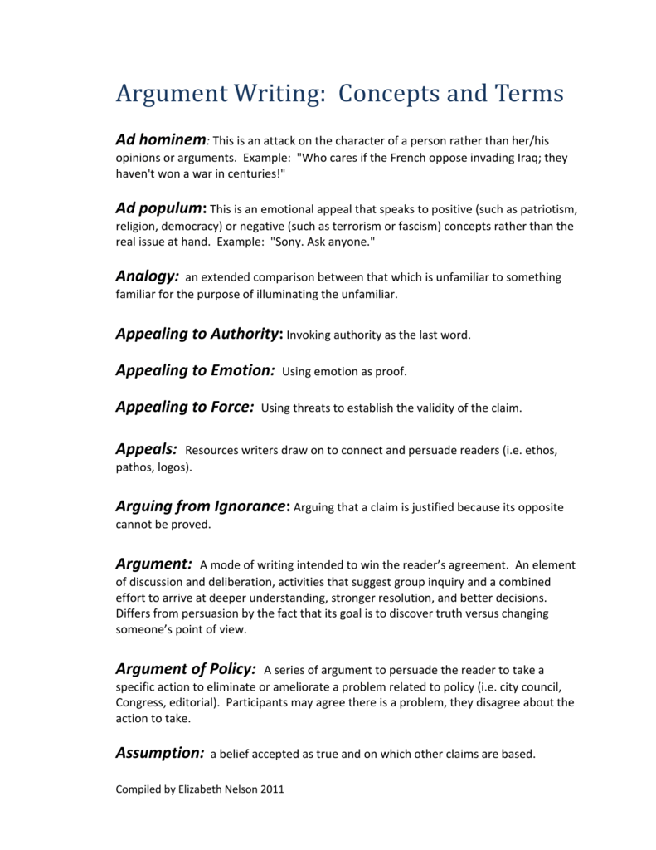
Over time, the arguments ‘ad’, as we might call them, have become quite a sizable group.

Slide 38
We will look at 4 of the more frequently occurring
‘ad’ fallacies, the argumenta ad populum (Popularity), ad baculum (Force),ad misericordiam (Pity), ad Ignorantiam (Ignorance)
We will leave the discussion of another important fallacy the argumentum ad verecundiam (Authority) for next week when we will also talk about experts credibility

Slide 39
Ad Populum
There is an old adage to the effect that “thousands of people can’t be wrong.”
And yet, as we frequently learn to our chagrin, thousands
of people often are wrong: they support dictators, engage in unhealthy lifestyles, or put their money into schemes that seem to have little chance of success

Slide 40
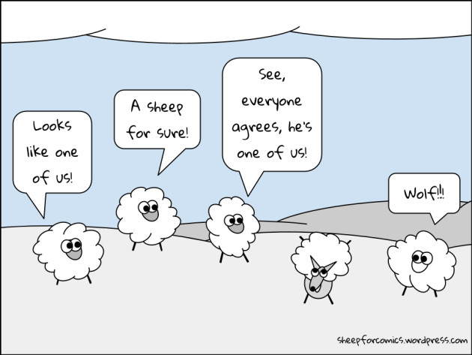
All this leads us to ask what weight we should place on such popularity when it is advanced in support of a cause or claim.
Where the weight is unwarranted the argument commits the ad populum fallacy, or an illicit appeal to popularity

Slide 41

EXAMPLE 1
But officer, I don't deserve a ticket; everyone goes this speed. If I went any slower, I wouldn't be going with the stream of traffic

Slide 42
Example 2
For the non-elected staff at the Ottawa Hospital Research Institute to get grants of millions of dollars, to do their own thing “in the still-controversial field of stem cell research” shows that the OHRI thinks that “might is right.” Most taxpayers oppose experimenting on embryo stem cells because the scientific fact is that we are dealing with human life. Slow down OHRI and be aware of the fact that most taxpayers are in favour of research on adult stem cells but are totally opposed to research on embryo stem cells. Are ya listening?

Slide 43
There are different claims made here but each is supported by a key premise that appeals to popular (taxpayer) opinion.
However, it is not clear what the taxpayers opinion is on this matter in general.
It is not clear either what is the sample considered.
It is not even clear why taxpayers should have some say in this given that governments constantly spend money on all sort of things without consulting taxpayers.
So, why should we appeal to their authority in deciding this very specific matter and not others?

Slide 44
How to Avoid it? Ask yourself the following questions:
1. Is the appeal to a popular belief or practice so widely known to be correct that the burden of proof would lie with anyone who questioned it?
2. If not, and the burden lies with the arguer, has the popularity been adequately supported or explained (by a poll, for example)?

Slide 45
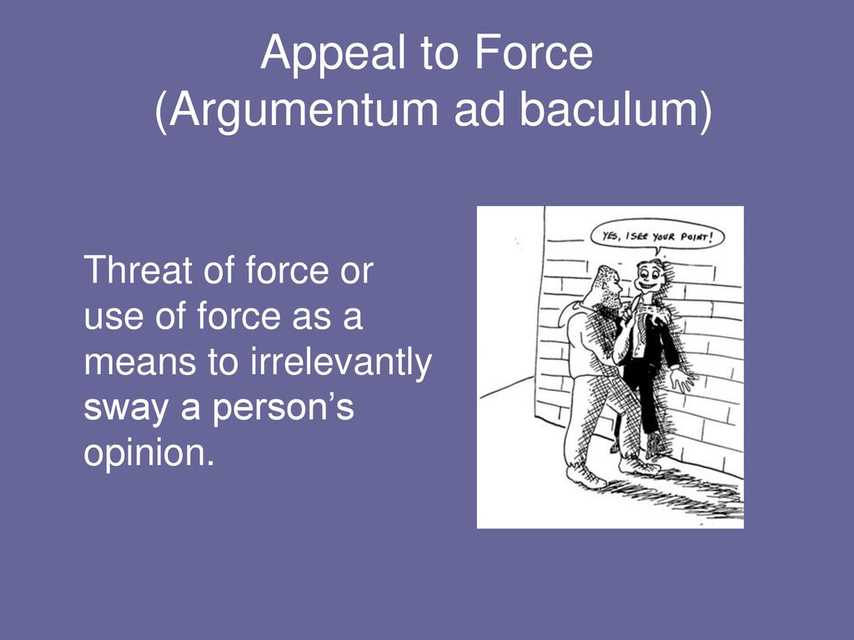
Ad Baculum
The fallacy is committed when one appeals to force or the threat of force to bring about the acceptance of a conclusion
The ad baculum contains implicitly or explicitly a threat. Behind this threat is often the idea that in the end, "Might makes right."
Threats, per se, however, are not fallacies because they involve behavior, not arguments.

Slide 46

EXAMPLE 1
The Department of Transportation needs to reconsider the speed limit proposals on interstate highways for the simple reason that if they do not, their departmental budget for Department of Transportation will be cut by 25%.

Slide 47
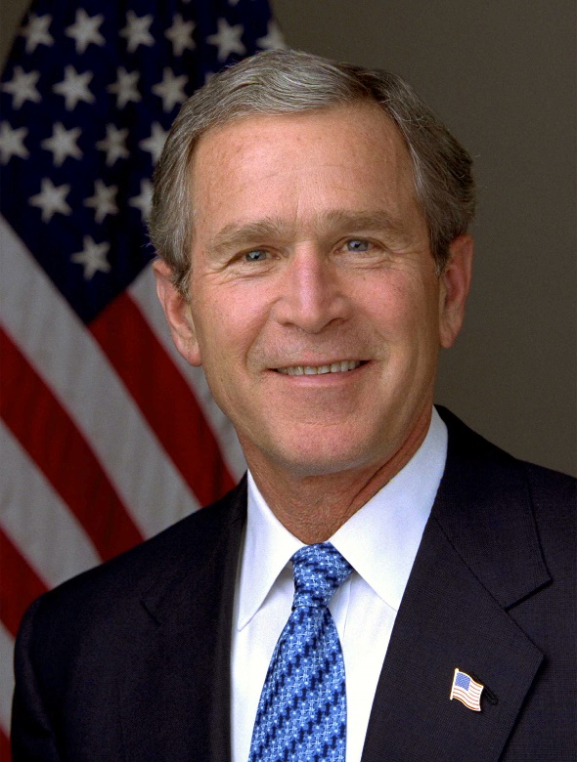
EXAMPLE 2
George Bush’s speech
More than two weeks ago, I gave Taliban leaders a series of clear and
specific demands: Close terrorist training camps. Hand over leaders
of the Al Qaeda network. And return all foreign nationals, including
American citizens, unjustly detained in their country. None of these
demands was met. And now, the Taliban will pay a price. By destroying
camps and disrupting communications, we will make it more difficult for the terror network to train new recruits and coordinate their evil plans. . . . Today we focus on Afghanistan, but the battle is broader. Every nation has a choice to make. In this conflict, there is no neutral ground. If any government sponsors the outlaws and killers of innocents, they have become outlaws and murderers themselves. And they will take that lonely path at their own peril.

Slide 48

First paragraph
Earlier set of demands that we might judge as threats and that were associated with specific consequences. The afghan government has failed to respond to these demands and now consequences are put in place.
Second paragraph
Here the threat is directed more obscurely at “every nation” whose government may sponsor outlaws and killers

Slide 49
How to Avoid it? Ask yourself the following questions:
1. Is this an argument in which a threat has been made insofar as negative consequences have been proposed or identified?
2. Is this a context in which such a strategy is appropriate
according to the procedures usual in that context, and is the introduction of the threat relevant to the reasonable conduct of the process?
3. Are there clear ways for the other party to comply so as to avoid the negative consequences?

Slide 50
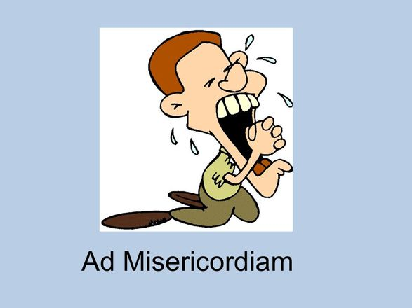
Ad Misericordiam
Emotional appeals are very common in reasoning. We often introduce our feelings into our argument because we have strong commitments or are deeply affected by what we take to be instances of injustice and the like. There is nothing wrong with this.
Since the time of Aristotle logicians have recognized a role for emotions in arguments because arguers address audiences as whole people.
But when attention is drawn away from what is actually at stake, or emotional appeals are substituted for good reasons, then we have candidates for fallacious arguments

Slide 51
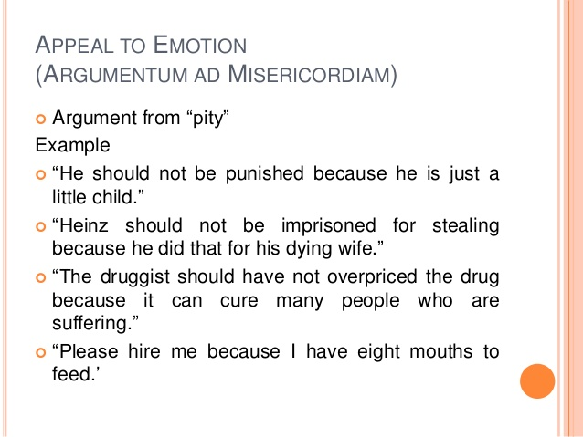
Ad misericordiam arguments are very good candidates for fallacious reasoning.
However, not all arguments ad misericordiam are fallacious even though most are

Slide 52
The idea here is to draw attention to some circumstance affecting you or someone else and gain the pity of your audience, on the basis of which they are led to a conclusion that they would not otherwise have likely accepted.

Slide 53
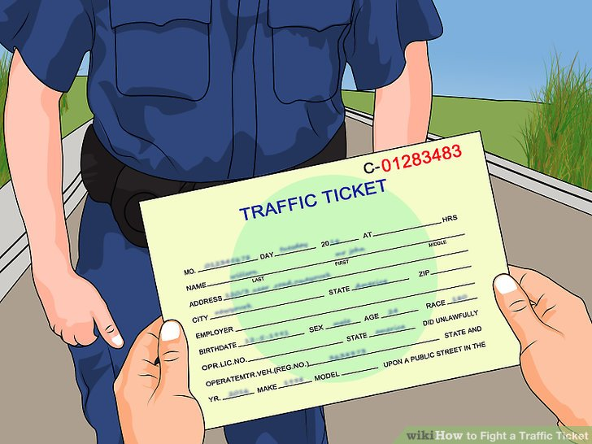
Example 1
Oh, Officer, There's no reason to give me a traffic ticket for going too fast because I was just on my way to the hospital to see my wife who is in serious condition to tell her I just lost my job and the car will be repossessed.

Slide 54

EXAMPLE 2
I have recently been informed by the Financial Aid Office that my
final average of 78.6 is 2% below what I need to renew my $5000 Scholarship. I may not be able to return without this scholarship

Slide 55
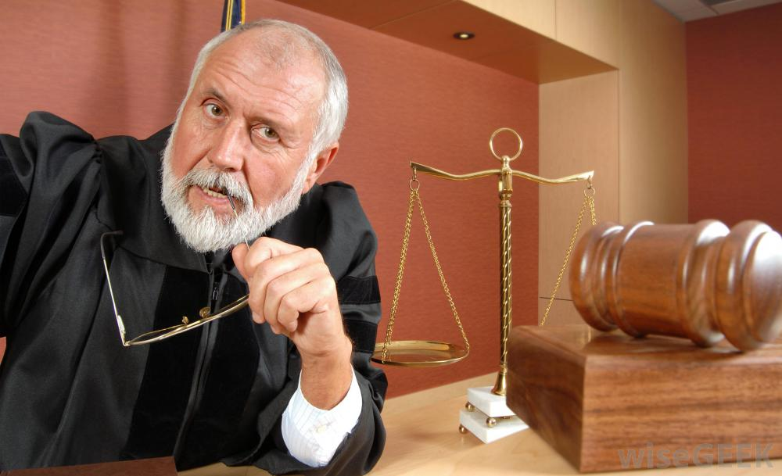
EXAMPLE 3
Your Honor, my incarceration is cruel and unusual punishment. First, my prison-issued shower sandals are grossly undersized. Secondly, the prison book club consists mainly of prisoners who club me with books.

Slide 56
How to Avoid it? Ask yourself the following questions:
1. Does the arguer appeal to pity in order to support the truth of a claim or recommend some action?
2. Is this a context in which emotional appeals are relevant?
3. Is the pity premise relevant to the conclusion being advanced?

Slide 57
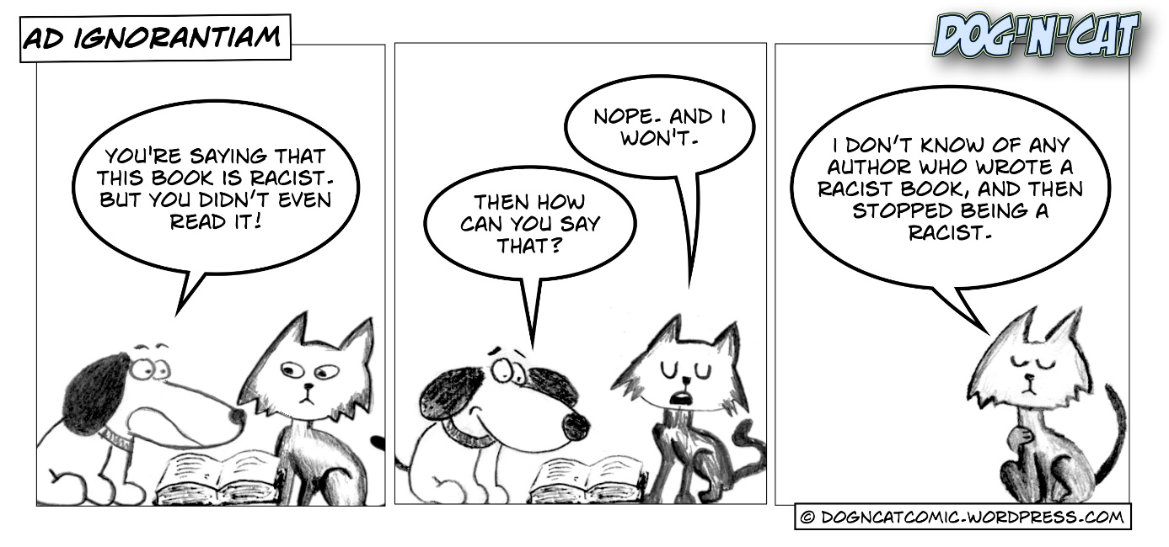
Ad Ignorantiam
the argumentative strategy in question involves drawing a conclusion on the basis of the absence of evidence against that conclusion

Slide 58
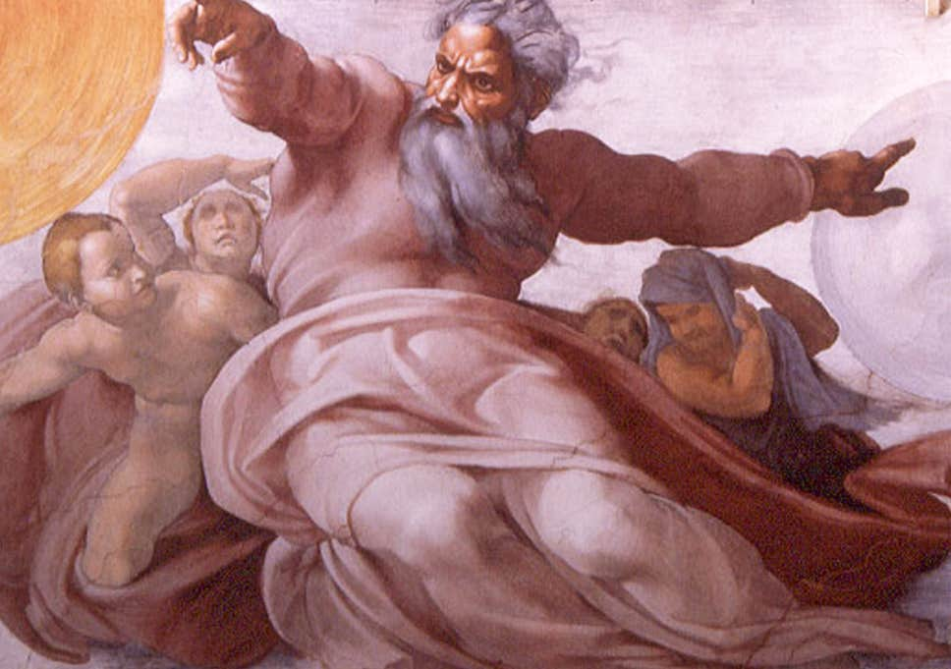
EXAMPLE 1
Someone might use the absence of evidence
disproving the existence of God as proof for the claim that God exists, on the grounds that if it did not, someone would have shown this by now.

Slide 59

EXAMPLE 2
Since the class has no questions concerning the topics discussed in class, the class is ready for a test

Slide 60

EXAMPLE 3
Our universe, however, did begin with the primordial explosion, since we can obtain no information about events that occurred before it. The age of the universe, therefore, is the interval from the big bang to the present." (Scientific American)

Slide 61
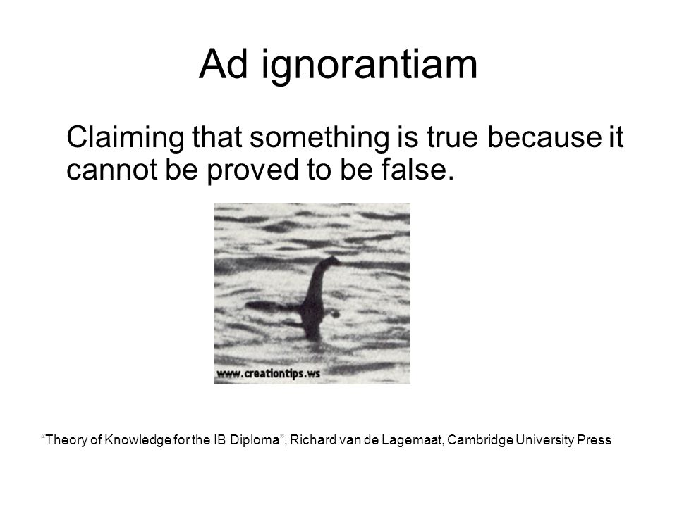
So to spot instances of this fallacy we need to locate conclusions that are drawn on the absence of evidence or look for conclusion that confuse absence of evidence with negative evidence

Slide 62
How to Avoid it? Ask yourself the following questions:
1. Is a conclusion being drawn that something is or is not
the case on the basis of an absence of evidence showing
otherwise?
2. Has there been a reasonable effort to search for evidence, or is
the absence of evidence for or against something really negative
evidence arising from the attempts to show otherwise?
3. Are the expectations for what should count as evidence reasonable
in the context?

Slide 63
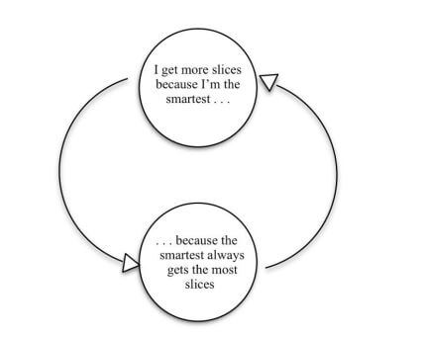
Begging the question (extra fallacy)
Circular reasoning that is deemed to be fallacious is said to ‘beg the question’.
Traditionally, this has been called the fallacy of petitio
principii

Slide 64
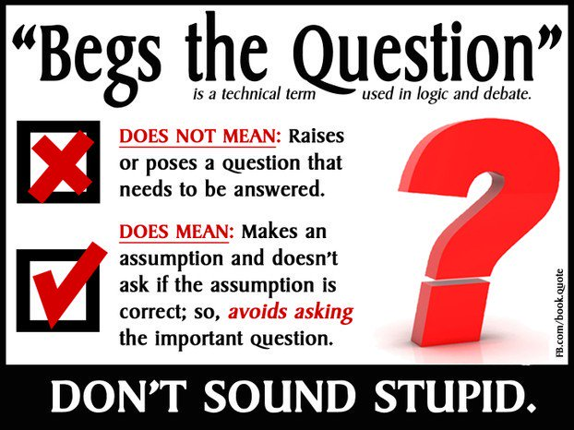
When told that an argument begs the question, it is appropriate for someone to wonder what question is being begged, because invariably with circular arguments there is no actual question being asked

Slide 65
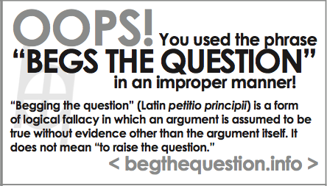
Someone begs the question when she assumes in the premises the very thing she is asserting in the conclusion. Since the same statement cannot be used to prove itself, the argument is circular.
In recent vernacular it has become popular to say someone begs the question simply when he raises an issue. That is not the traditional meaning of the phrase and not the way we are using it here.

Slide 66
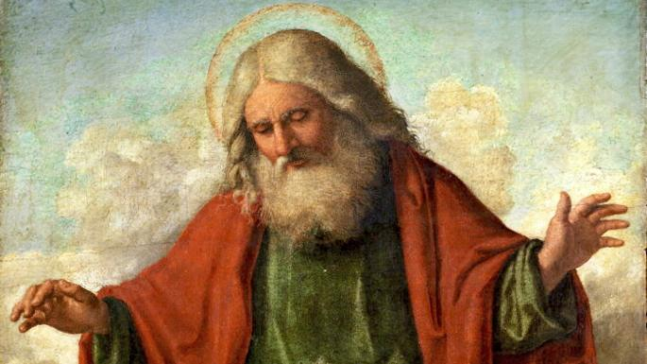
EXAMPLE 1
God is the only perfect being and perfection includes all the virtues. So, we know that God is benevolent.
REMEMBER: [Begging the Question involves trying to prove something by using ideas that already assume the truth of what it is you are trying to prove]/
In this case, if God has all the virtues, then the premise is already assuming that God has the virtue of benevolence, which is the very thing to be proved.

Slide 67
How to Avoid it? Ask yourself the following questions
1. Has the arguer avoided the obligation to provide independent support for a claim by restating it in similar terms?
2. Has an arguer avoided the obligation to provide independent support by assuming somewhere in the premises the very thing that has to be shown?

Slide 68


